Slide 1
Introducing Mapillary
May 2017
Boulder, CO

Slide 2
Our Technology
Street-level imagery – contributed by all, available to all
Building computer vision solutions for generating map data from photos
Using map data to improve maps—public, private, nonprofit, academic, cultural, historic, and more
All data is available for free use on OpenStreetMap
Commercial users must license the data

Slide 3
Computer Vision

Slide 4
Key Components
Structure from Motion
Image Recognition

Slide 5
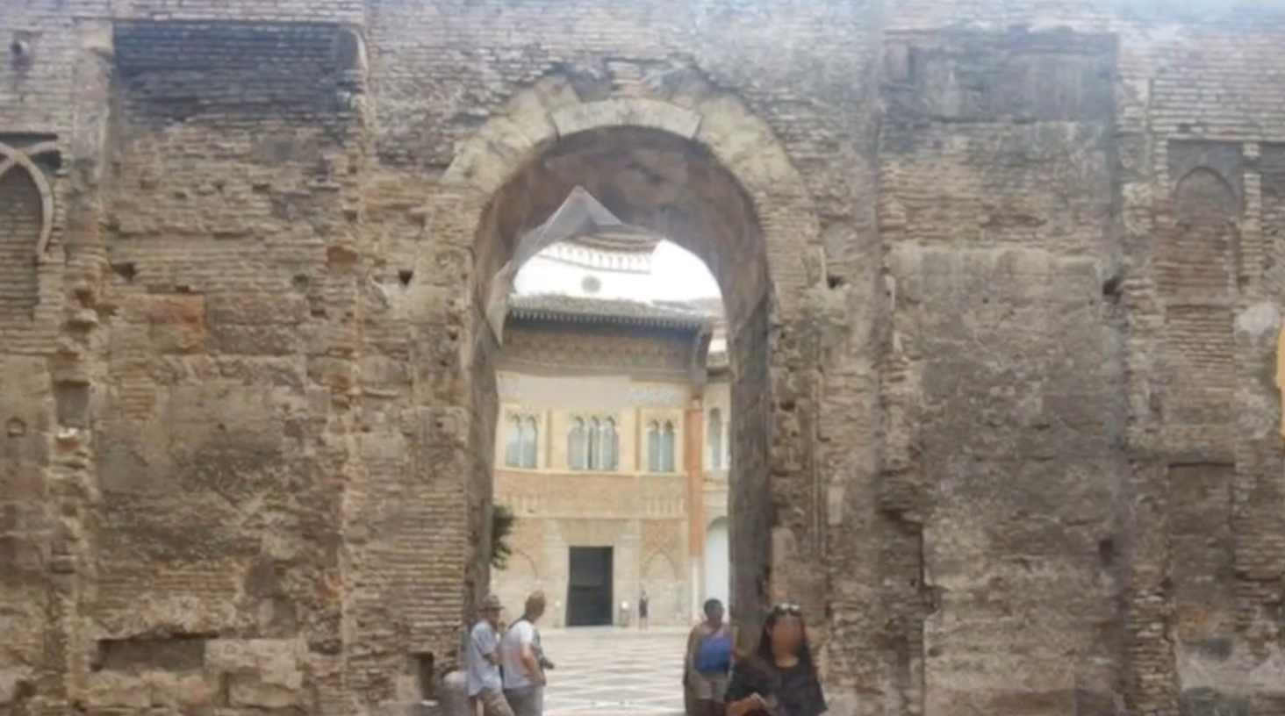
Structure from Motion (SfM)
Estimating three-dimensional structures and camera motions
from image sequences.

Slide 6


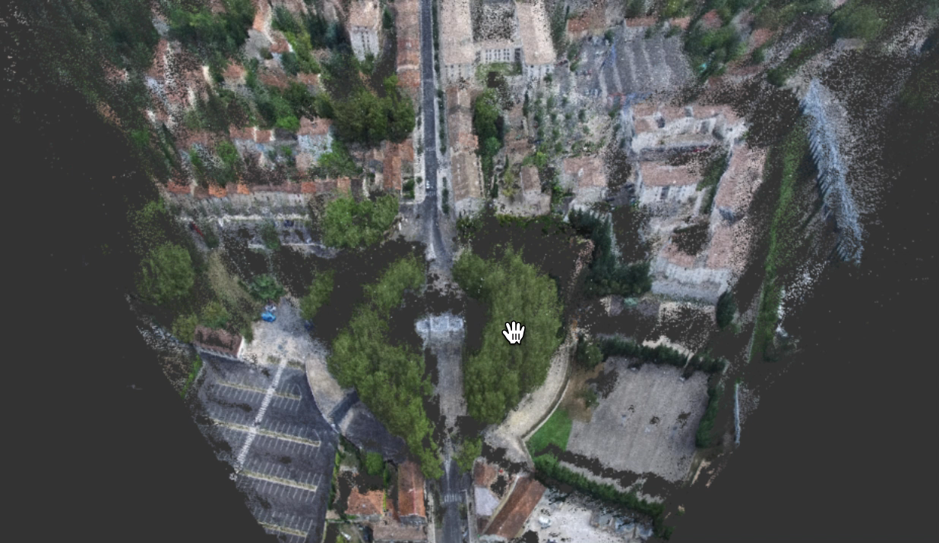
Structure from Motion (SfM)
- One of the best SfM tool in the open!
- Power to OpenDroneMap’s SfM pipeline

Slide 7
Image Recognition
.
Face and license plate detection
Traffic Sign Recognition
Text Recognition
Semantic Segmentation

Slide 8
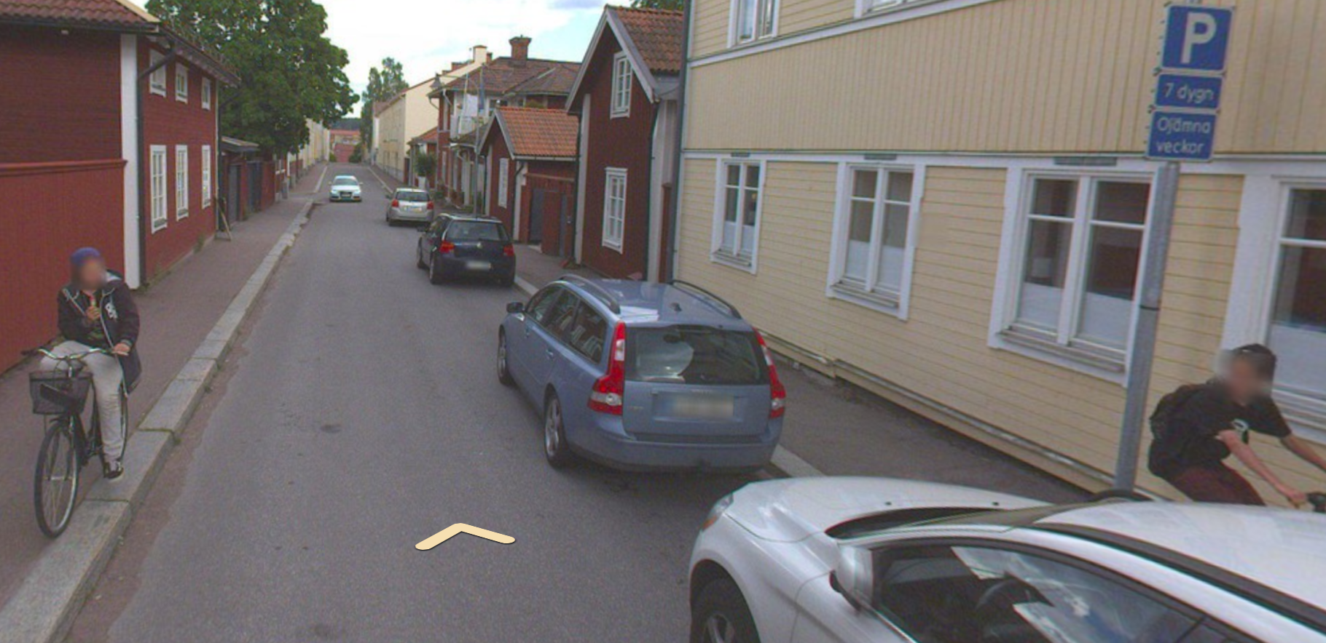
Face and license plate detection
Detect and blur faces and license plates for privacy protection
.
Falun, Sweden

Slide 9
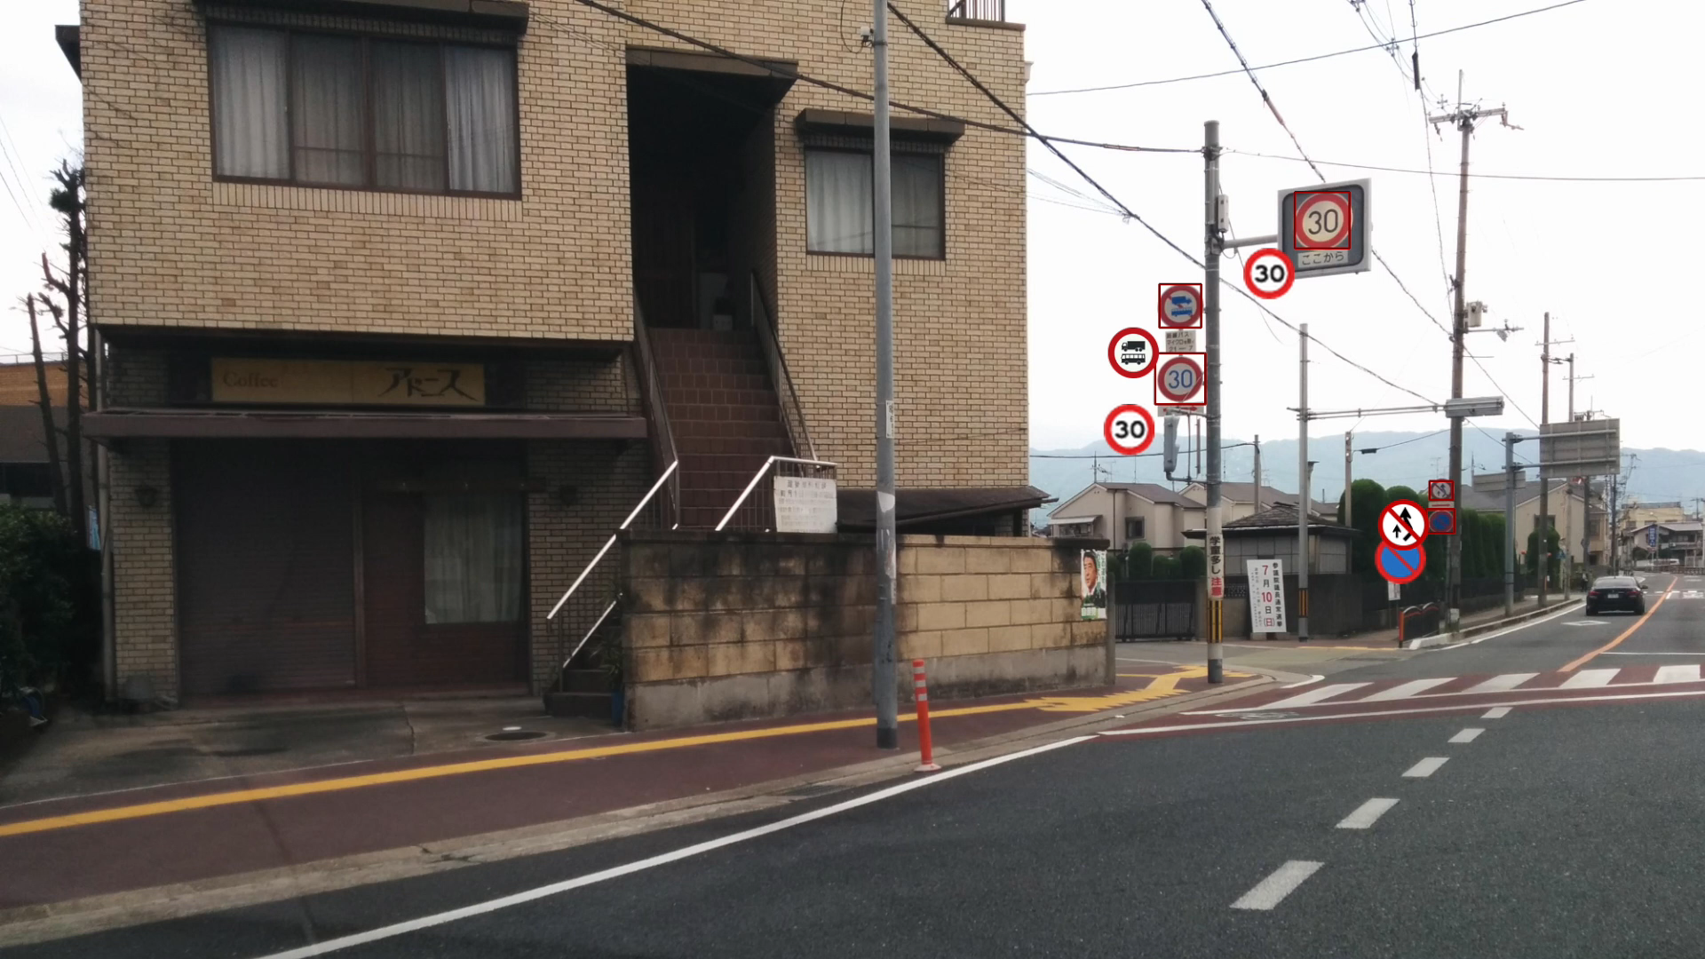
Traffic Sign Recognition
Detect and recognize traffic signs
Supports ~900 signs across ~60 countries
.
Japan

Slide 10
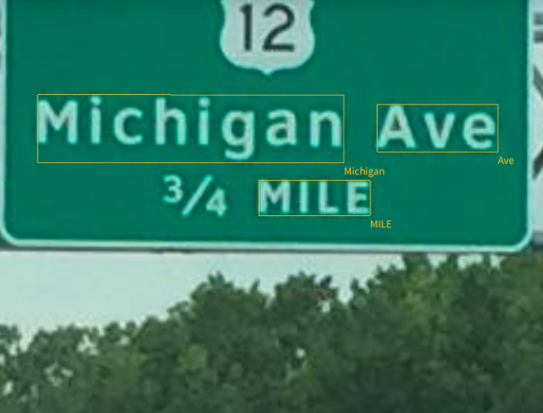
Text Recognition
- Detect and recognize texts on highway signs
.

Slide 11
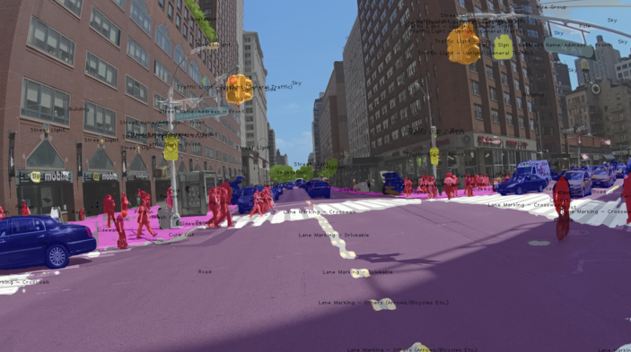
Semantic Segmentation
Label each pixel in an image with a class of objects e.g. sky, tree, car ..
Currently supports 72 object classes (100+ classes annotated)
4-lever target: 80 classes

Slide 12
SfM + Recognition
3D structures from SfM
+
Semantic information from Recognition
Map Objects

Slide 13
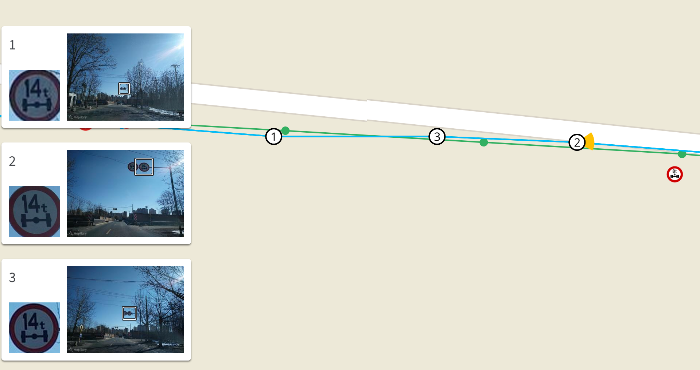
Traffic Sign Map Objects

Slide 14
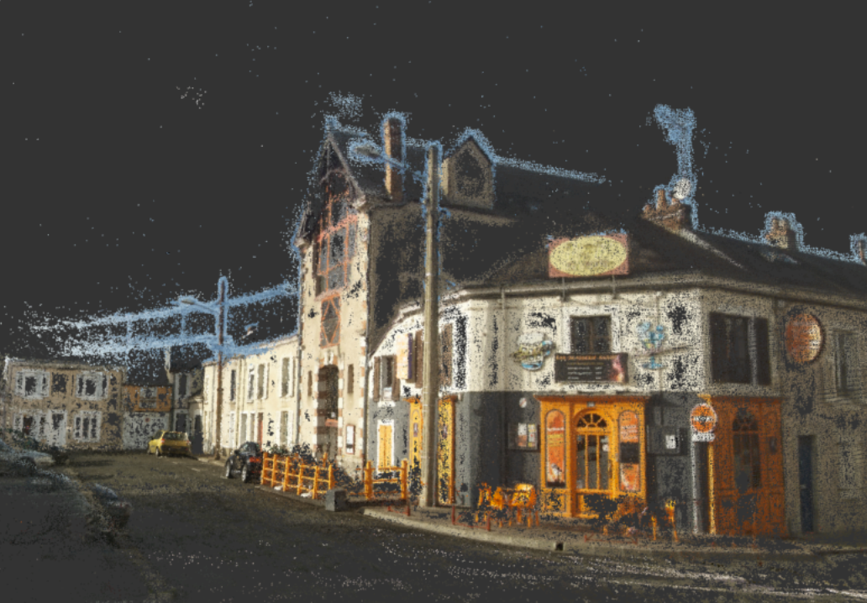

Slide 15
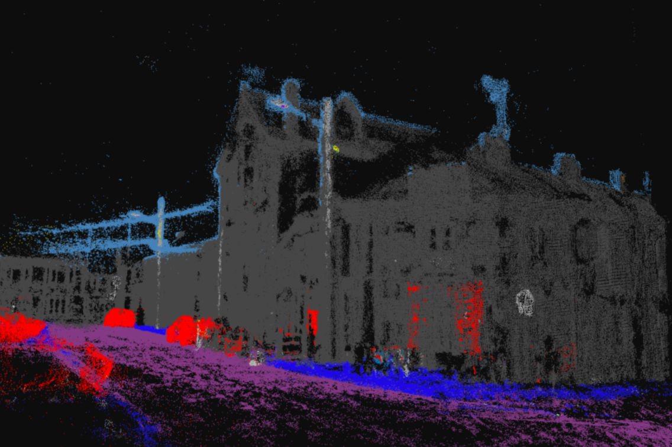
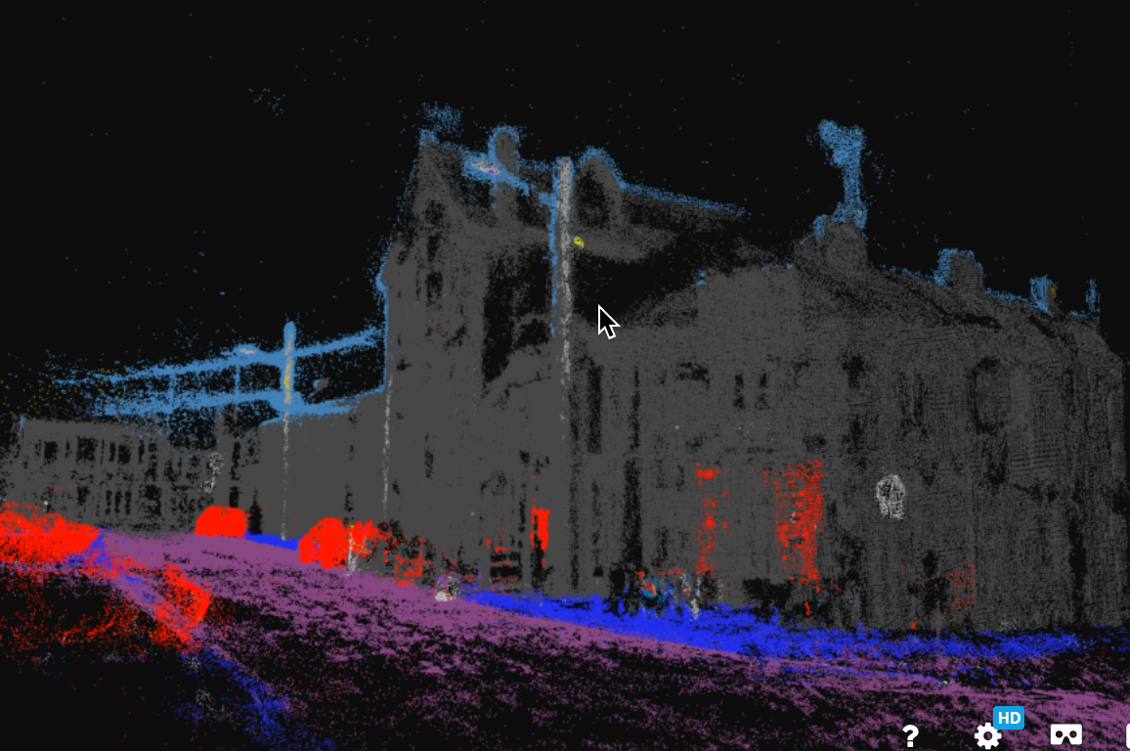

Slide 16
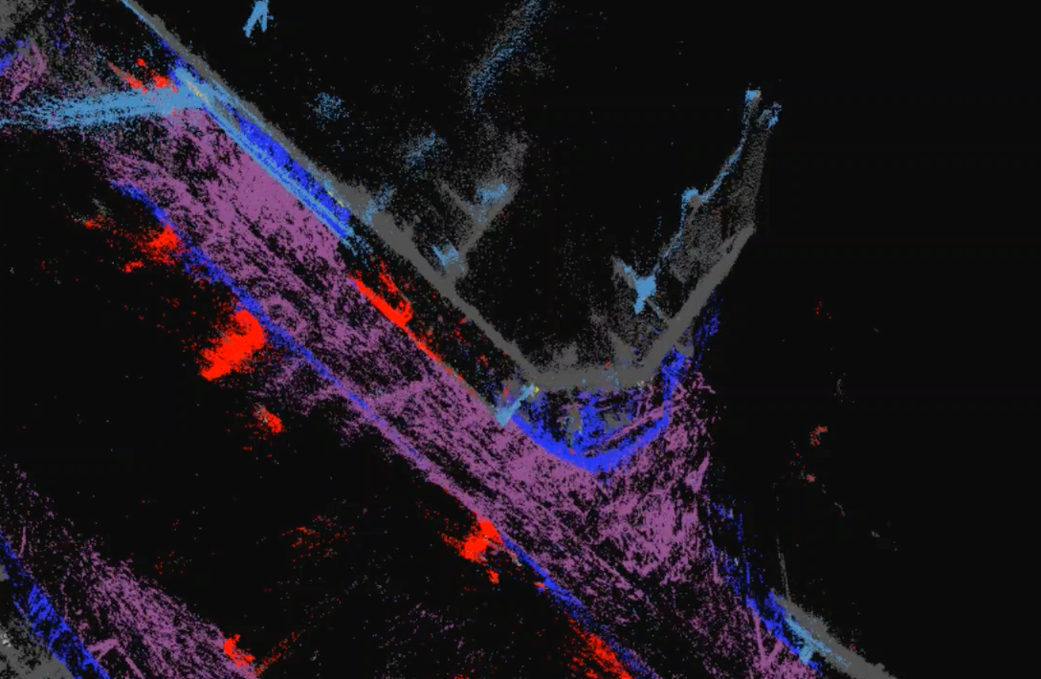

Slide 18
Building
Curb
Sidewalk
Street Light

Slide 19

Capturing Photos

Slide 20
Map your world.

Slide 21
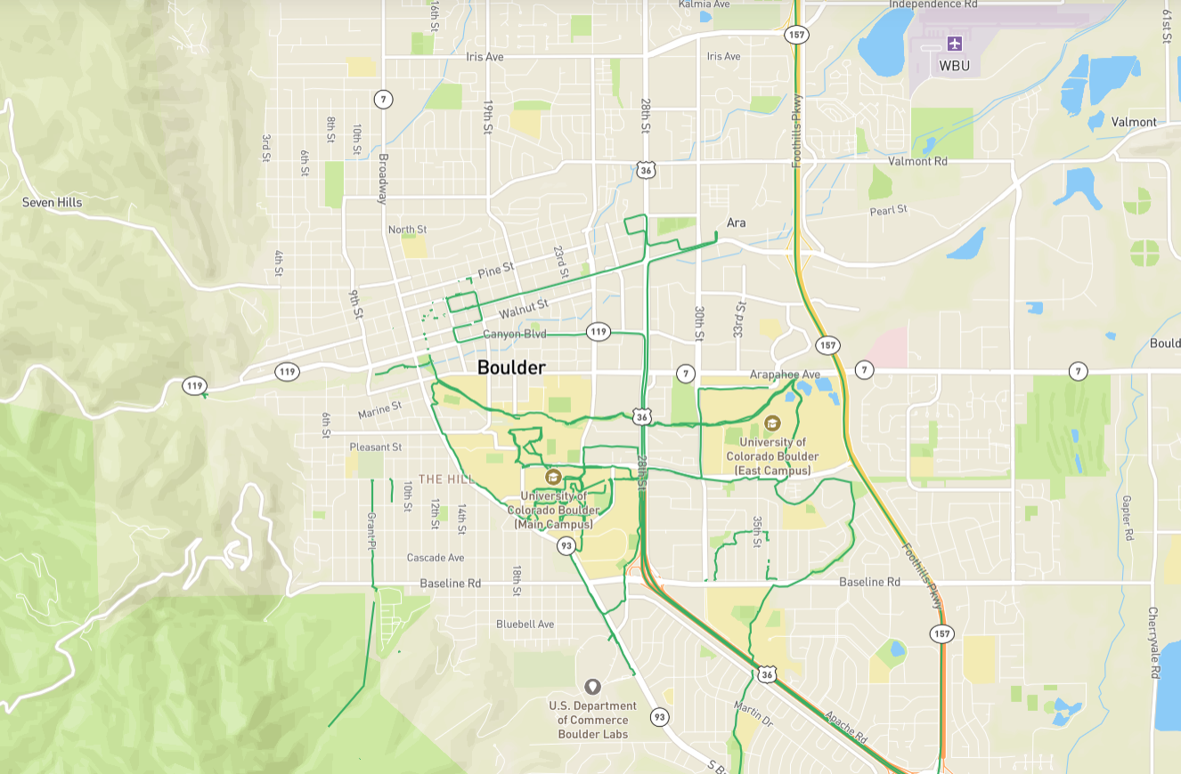
Boulder, Colorado

Slide 22
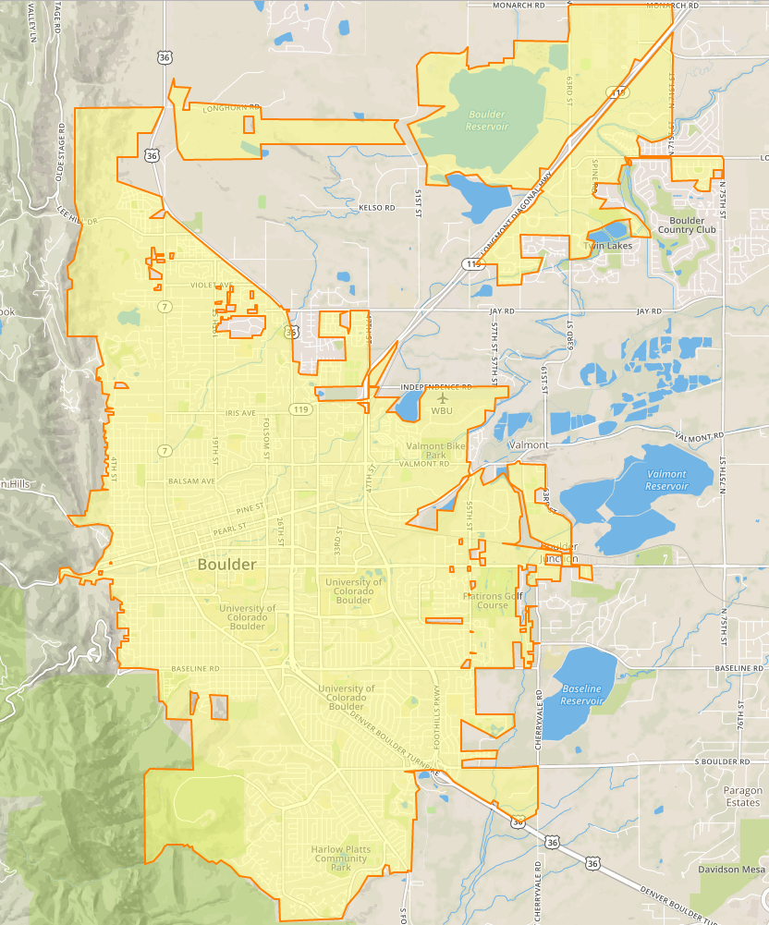

Slide 23
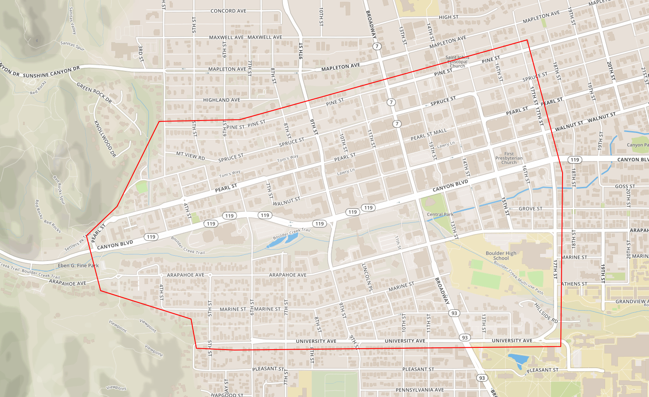
Let’s map!

Slide 24
Equipment
5x LG 360 cameras (link to mobile phone)
Your mobile phone + Mapillary app
Bike and car mounts

